Slide 1
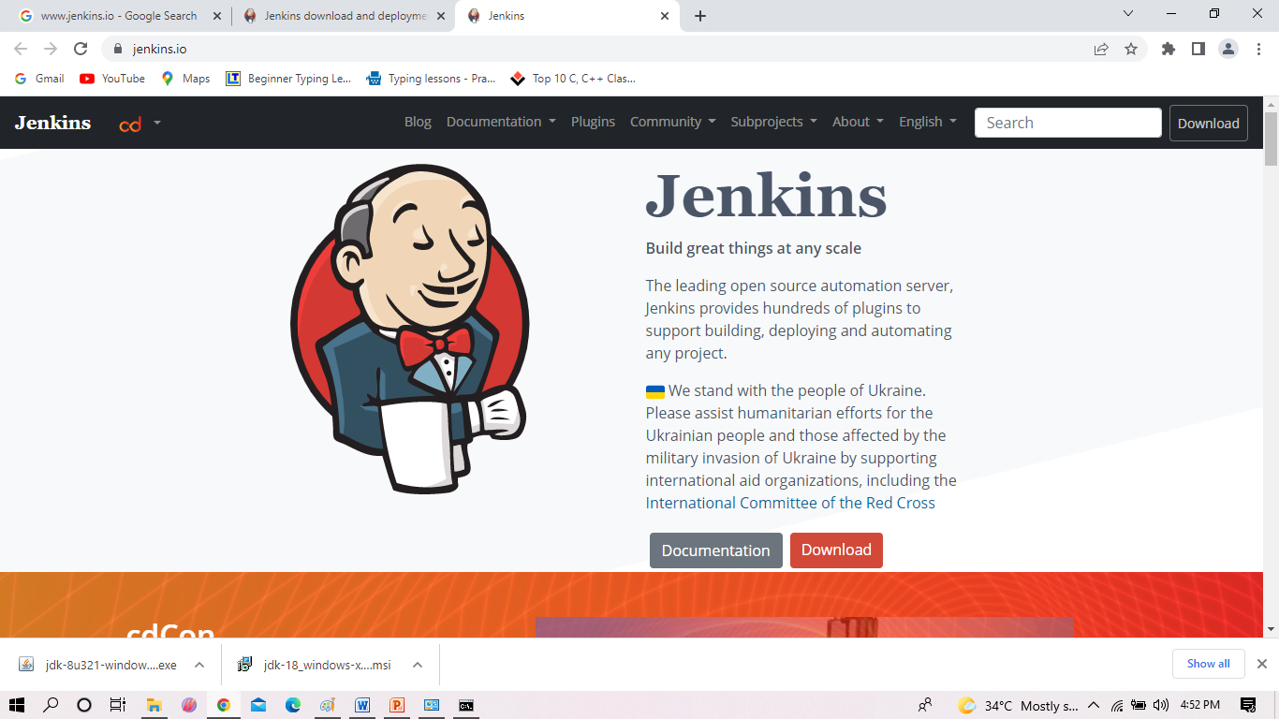
Installation of Jenkins

Slide 2
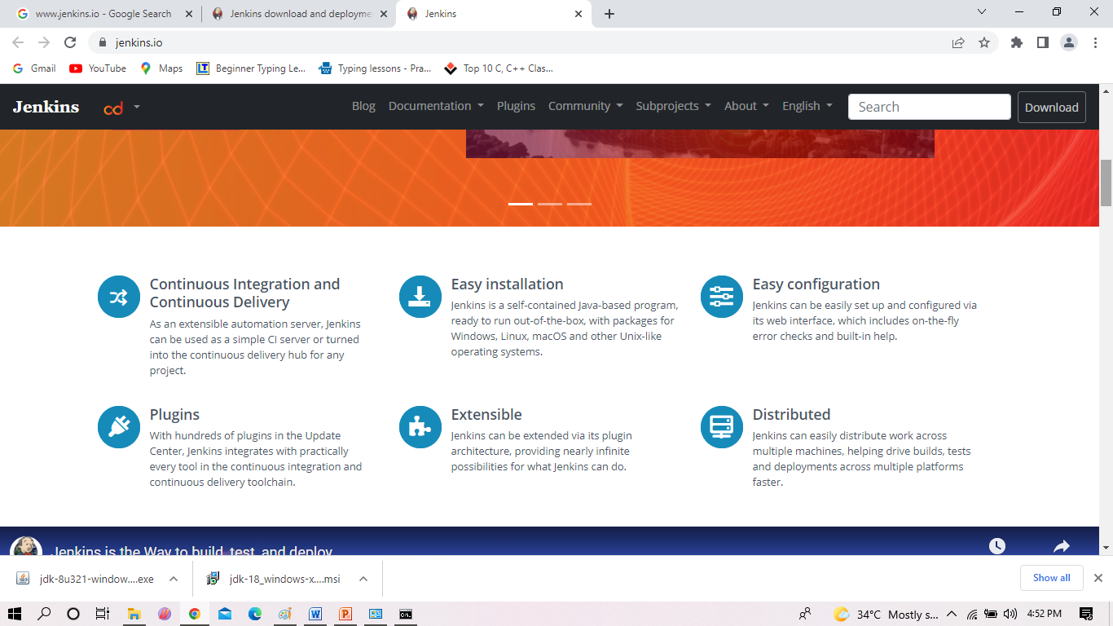
Installation of Jenkins Contd..

Slide 3
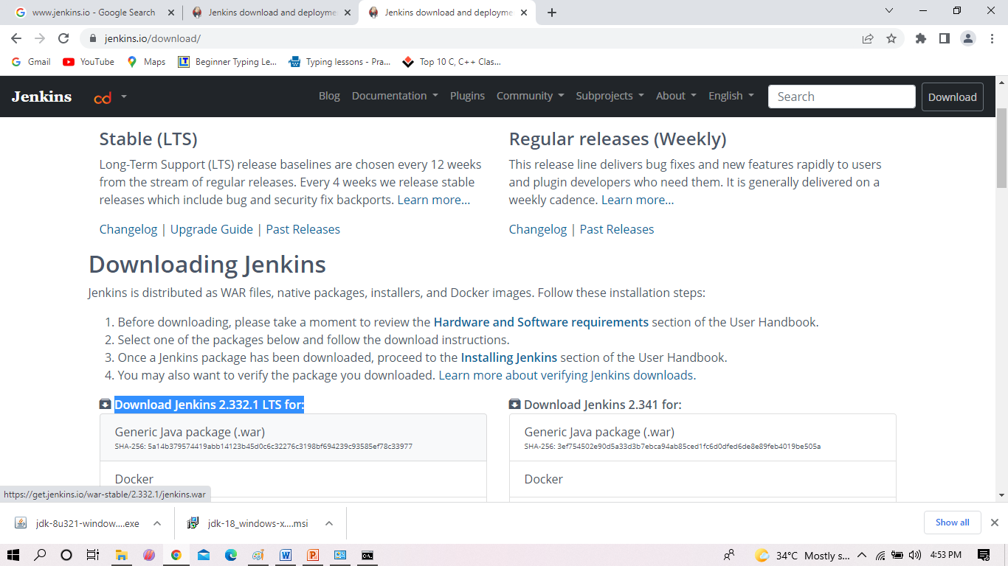
Installation of Jenkins Contd..

Slide 4
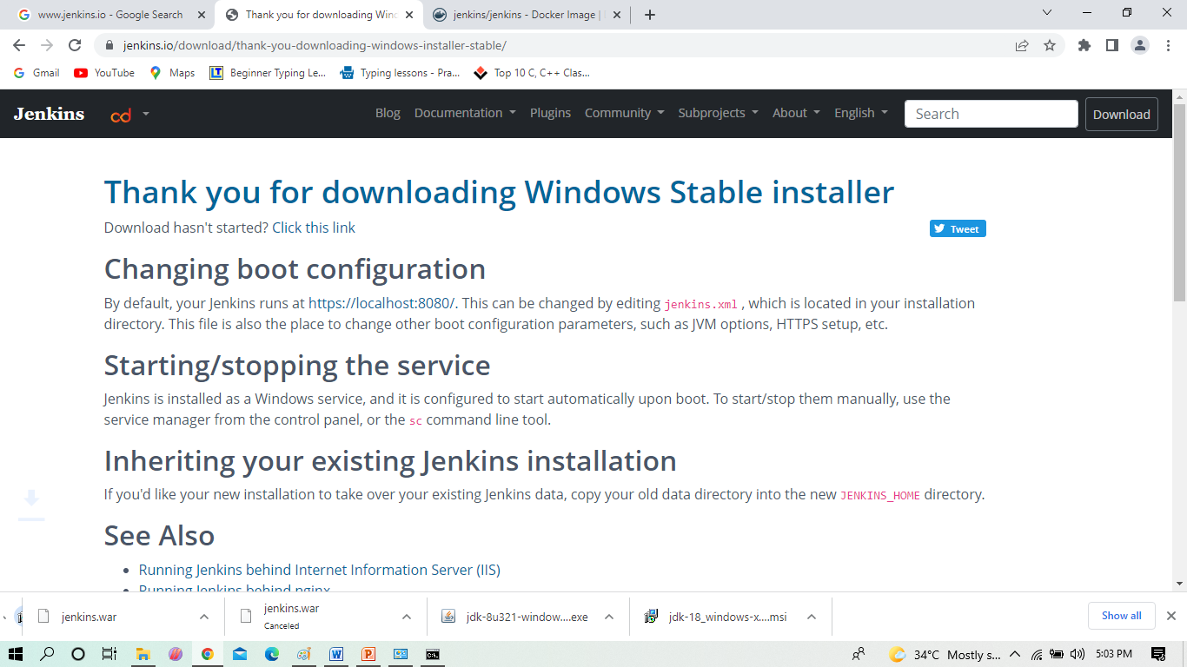
Installation of Jenkins Contd..

Slide 5
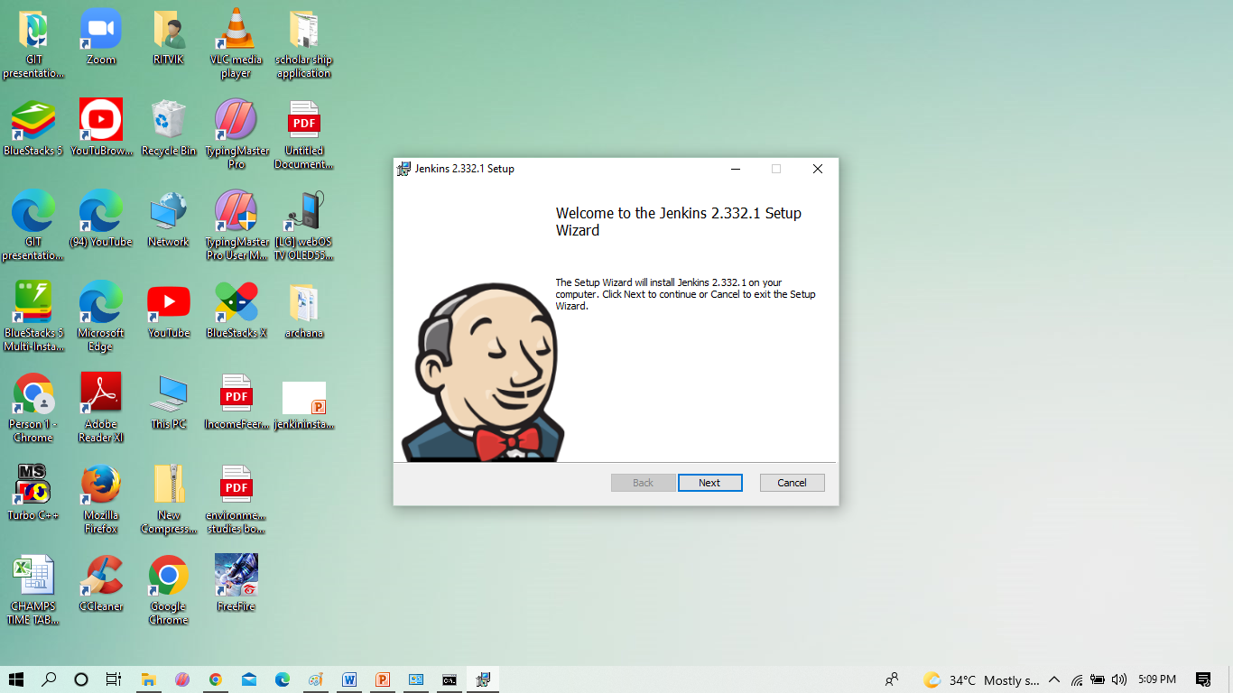
Installation of Jenkins Contd..

Slide 6
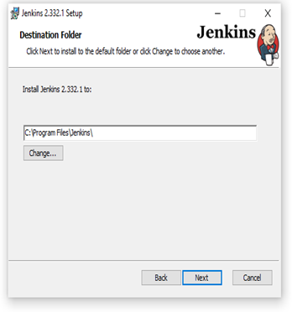
Installation of Jenkins Contd..

Slide 7
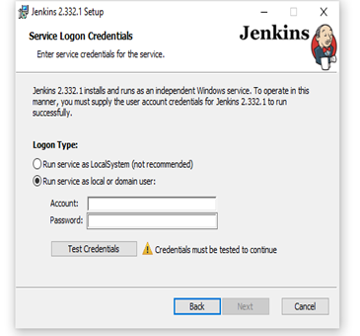
Installation of Jenkins Contd..

Slide 8
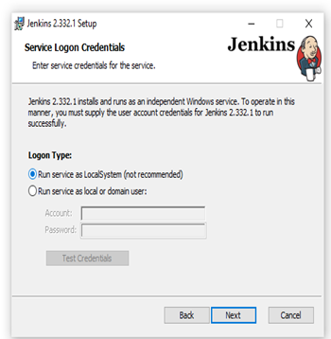
Installation of Jenkins Contd..

Slide 9
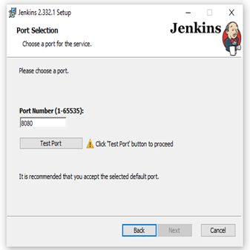
Installation of Jenkins Contd..

Slide 10
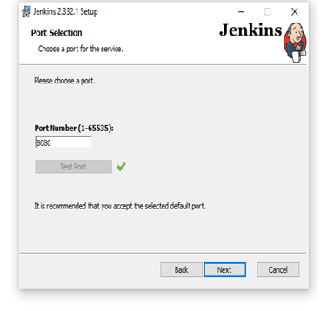
Installation of Jenkins Contd..

Slide 11
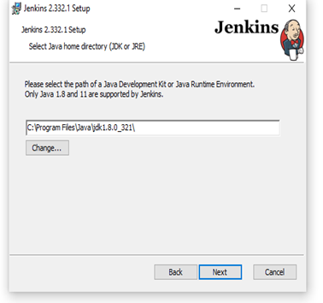
Installation of Jenkins Contd..

Slide 12
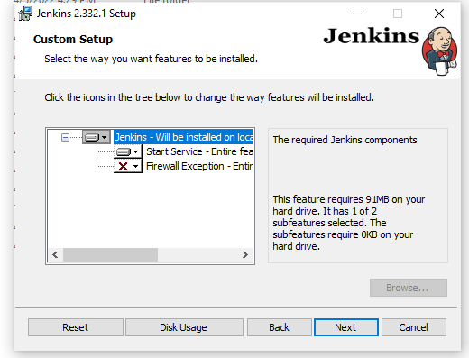
Installation of Jenkins Contd..

Slide 13
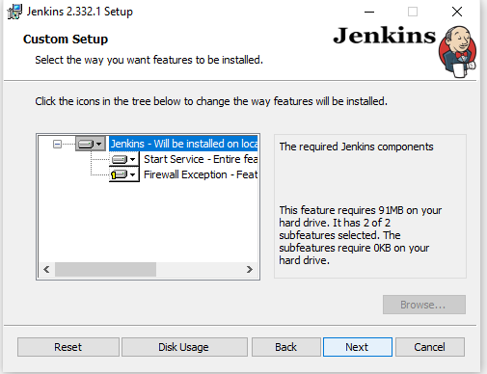
Installation of Jenkins Contd..

Slide 14
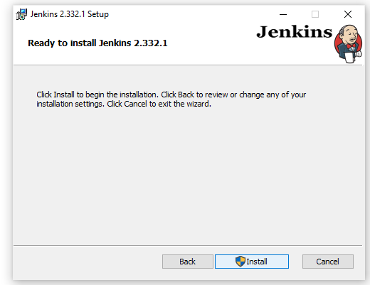
Installation of Jenkins Contd..

Slide 15
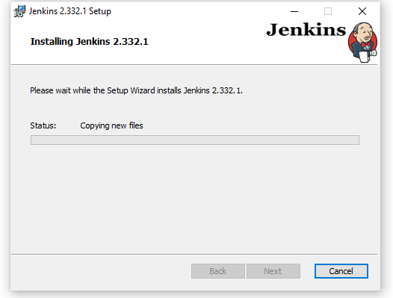
Installation of Jenkins Contd..

Slide 16
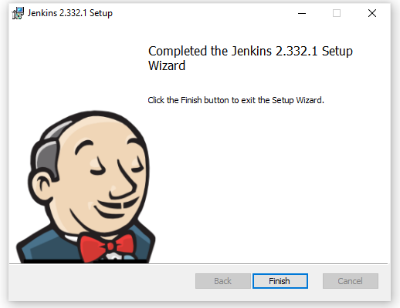
Installation of Jenkins Contd..

Slide 17
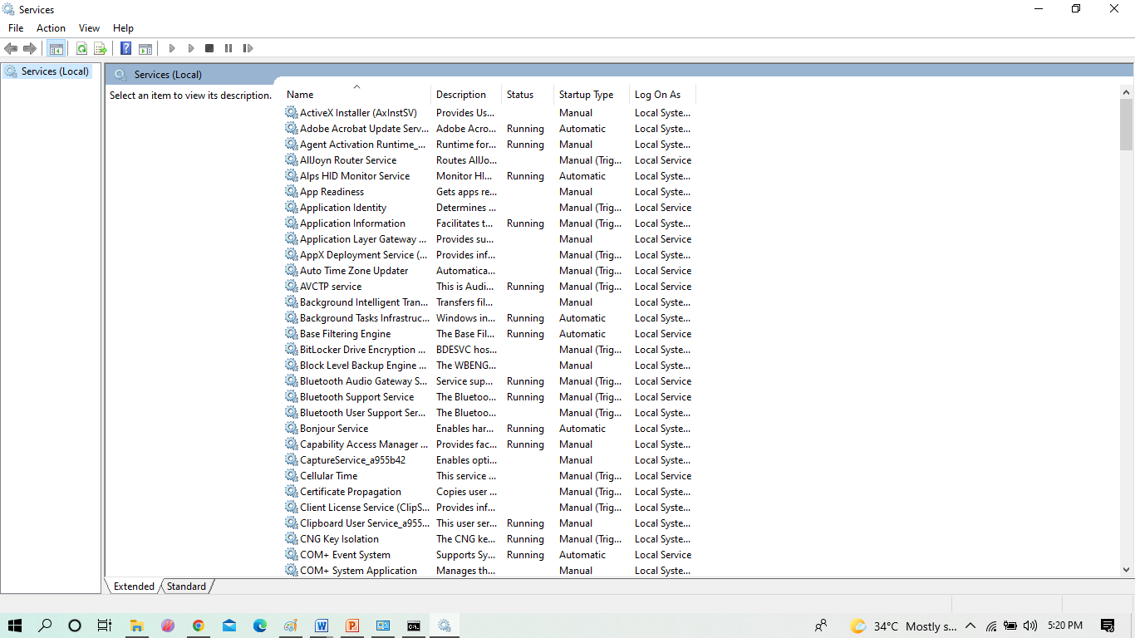
Installation of Jenkins Contd..

Slide 18
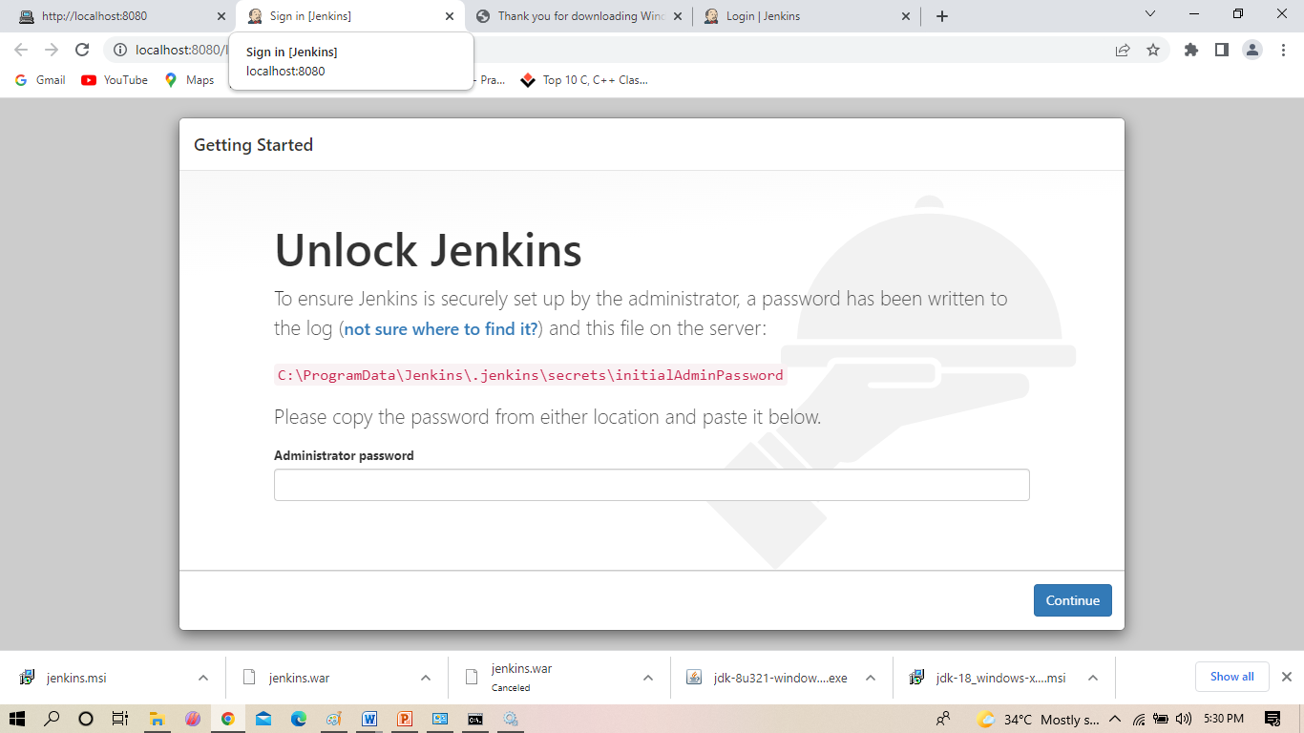
Installation of Jenkins Contd..

Slide 19
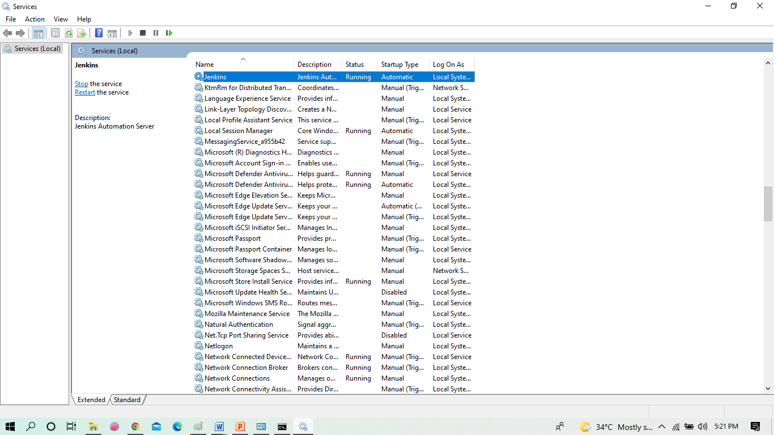
Installation of Jenkins Contd..

Slide 20
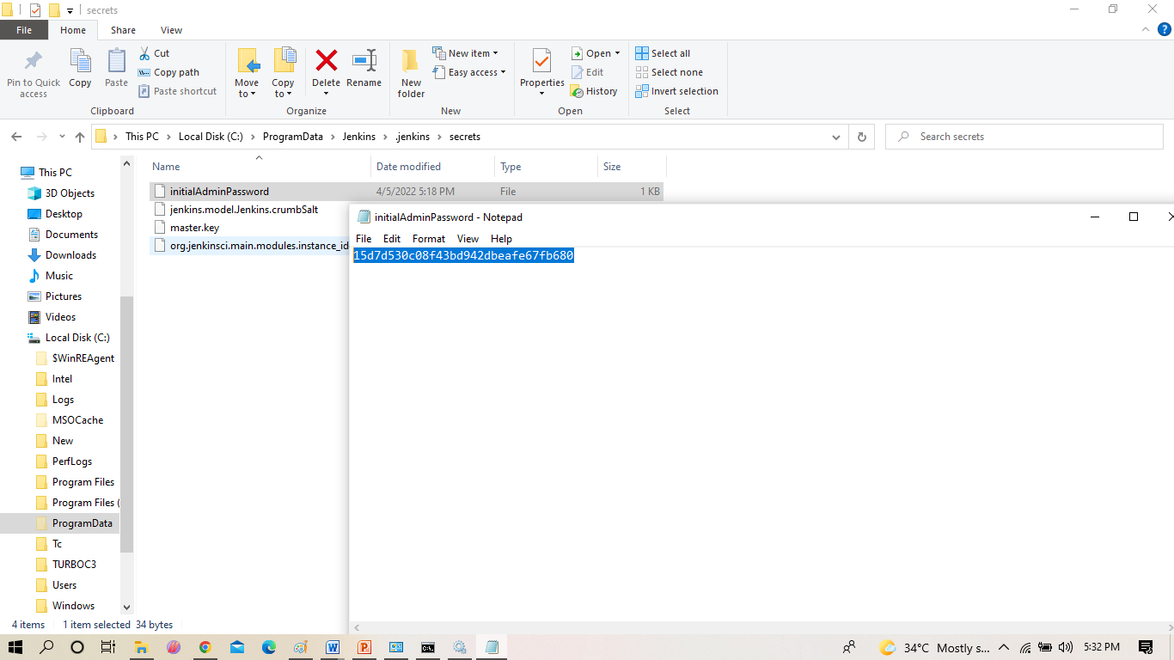
Installation of Jenkins Contd..

Slide 21
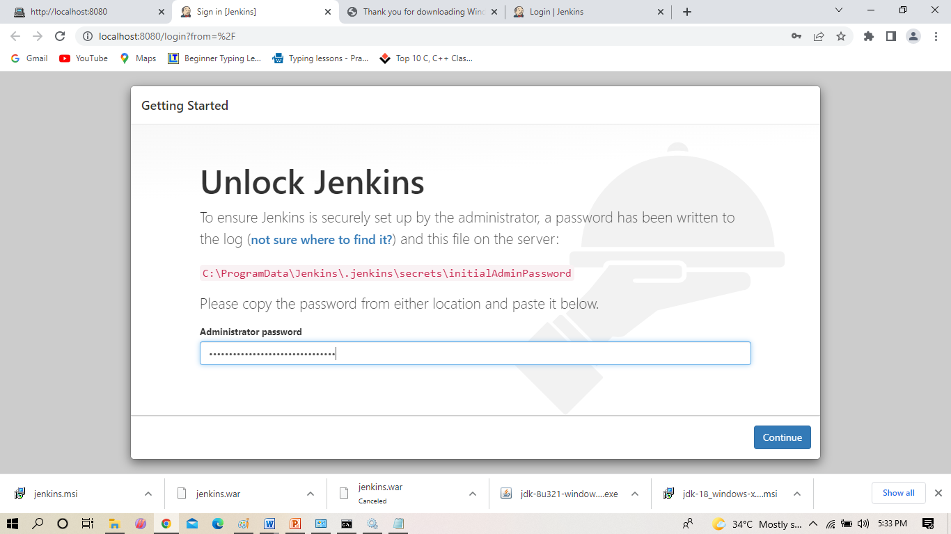
Installation of Jenkins Contd..

Slide 22
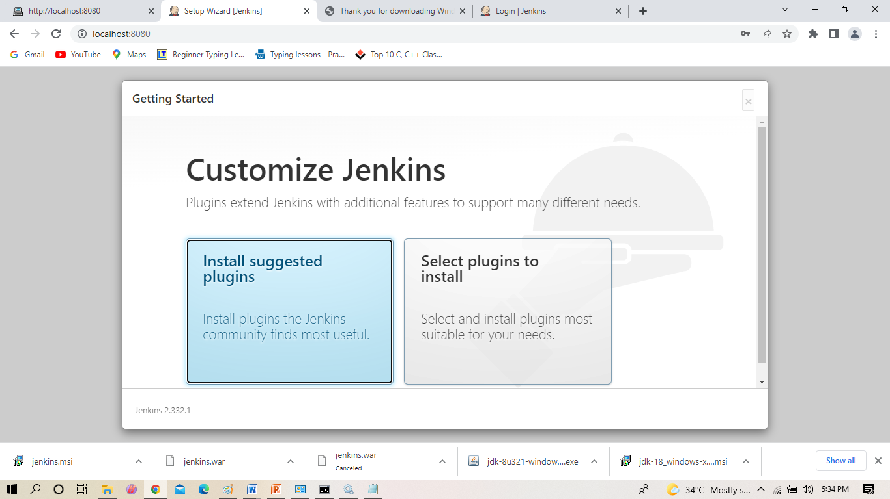
Installation of Jenkins Contd..

Slide 23
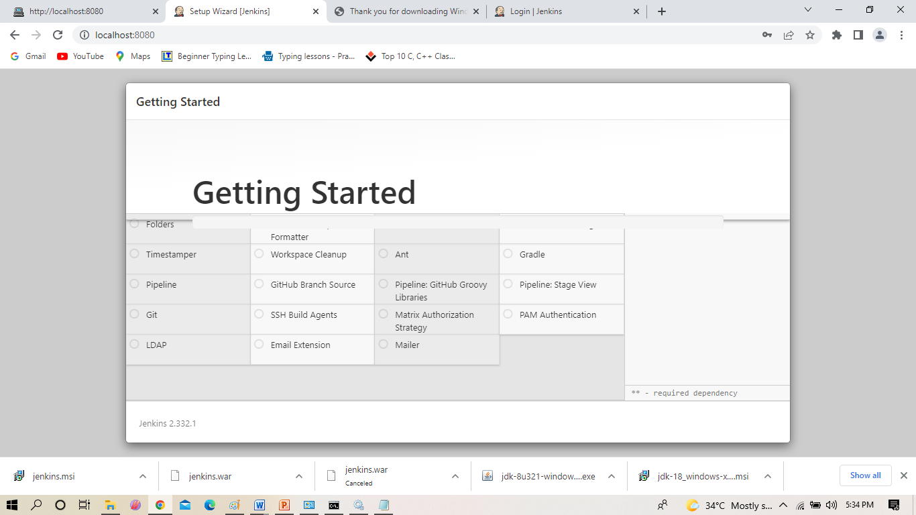
Installation of Jenkins Contd..

Slide 24
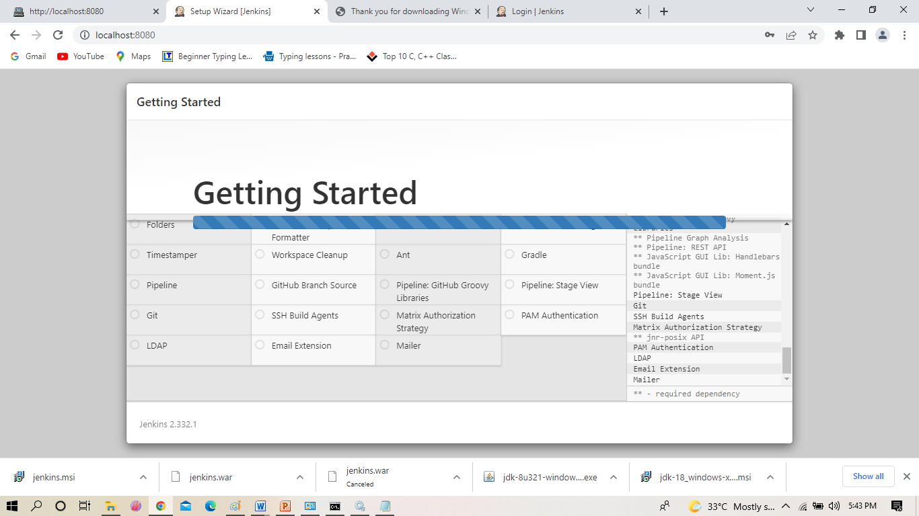
Installation of Jenkins Contd..

Slide 25
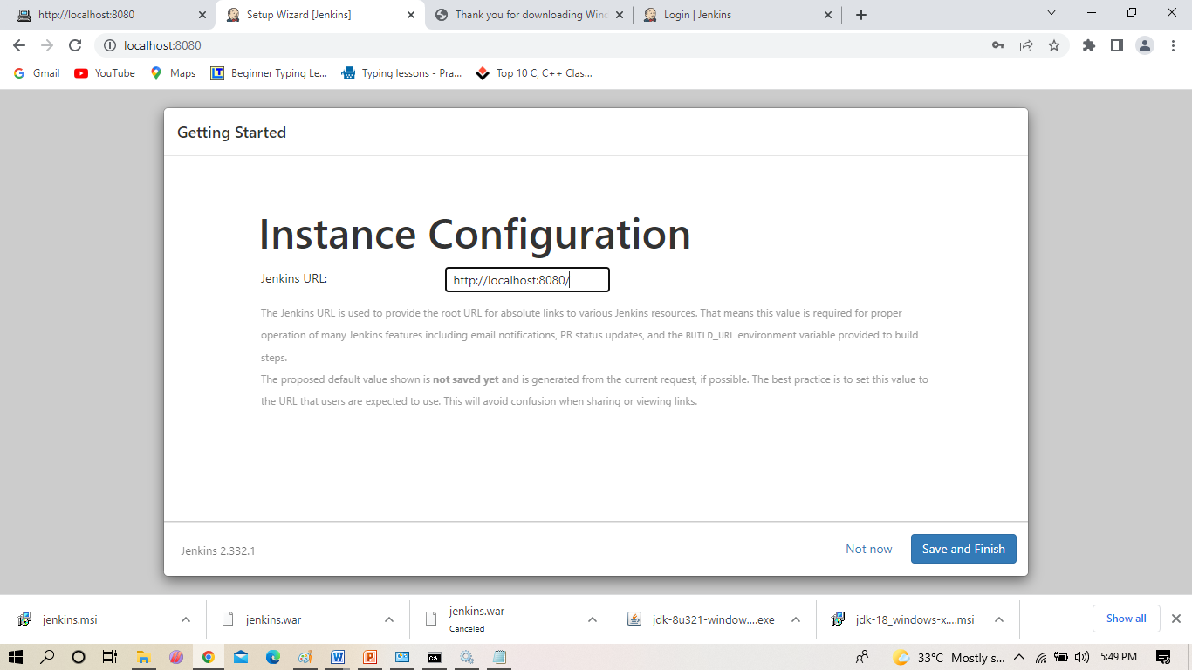
Installation of Jenkins Contd..

Slide 26
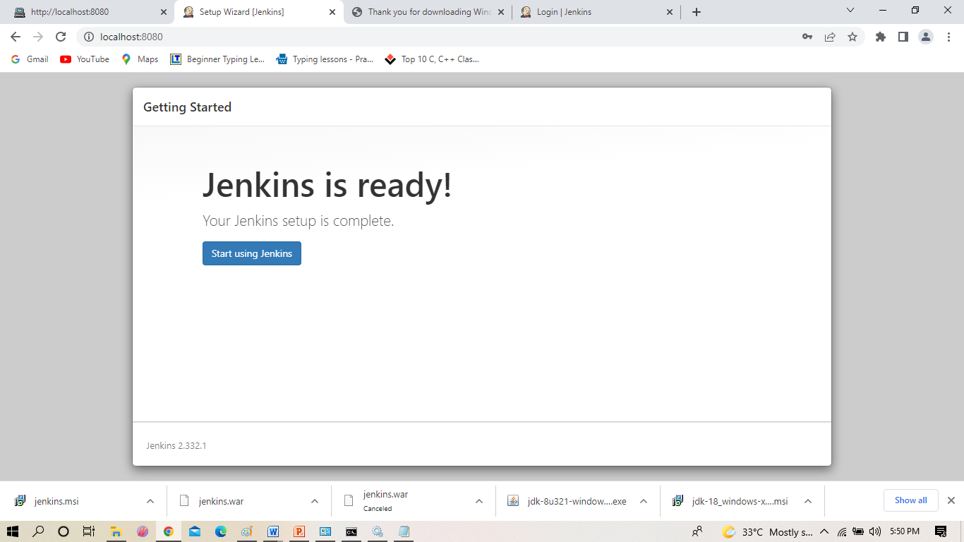
Installation of Jenkins Contd..
Installation of Jenkins Contd..

Slide 27
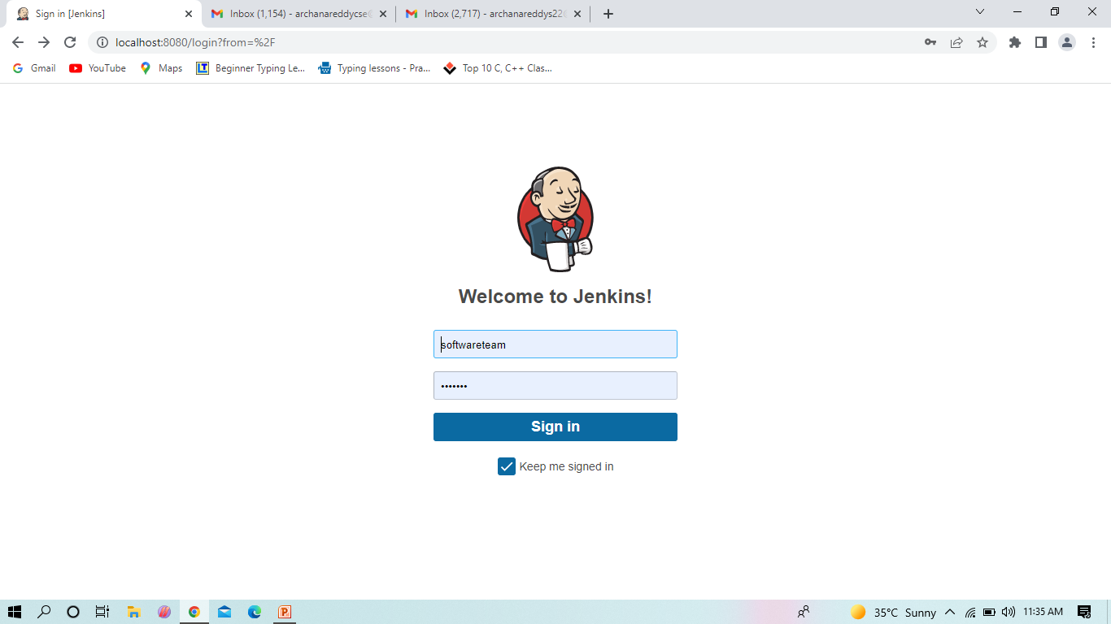
Installation of Jenkins Contd..

Slide 28
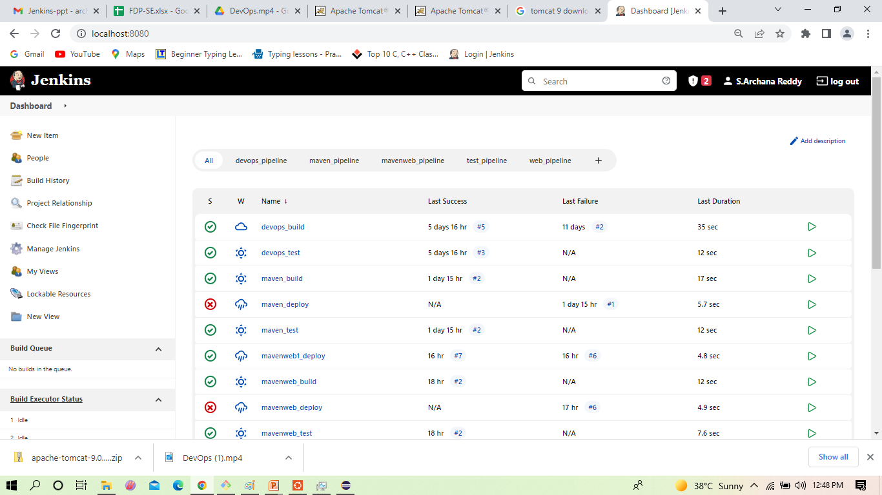
Select ->Manage jenkins
Install plugins in Jenkins Contd..

Slide 29
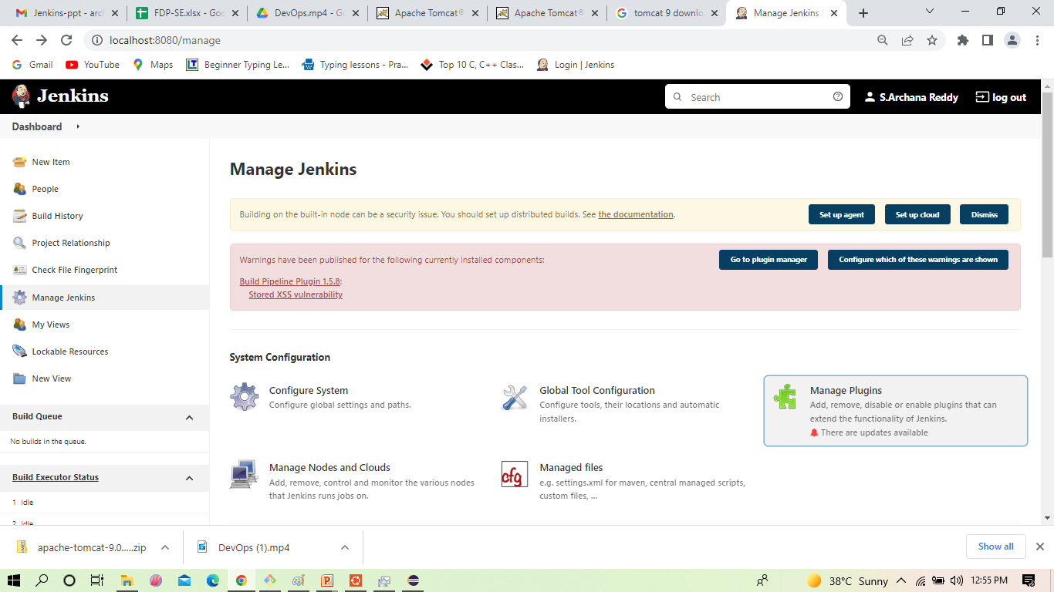
Click on manage jenkins
Installation of Jenkins Contd..

Slide 30
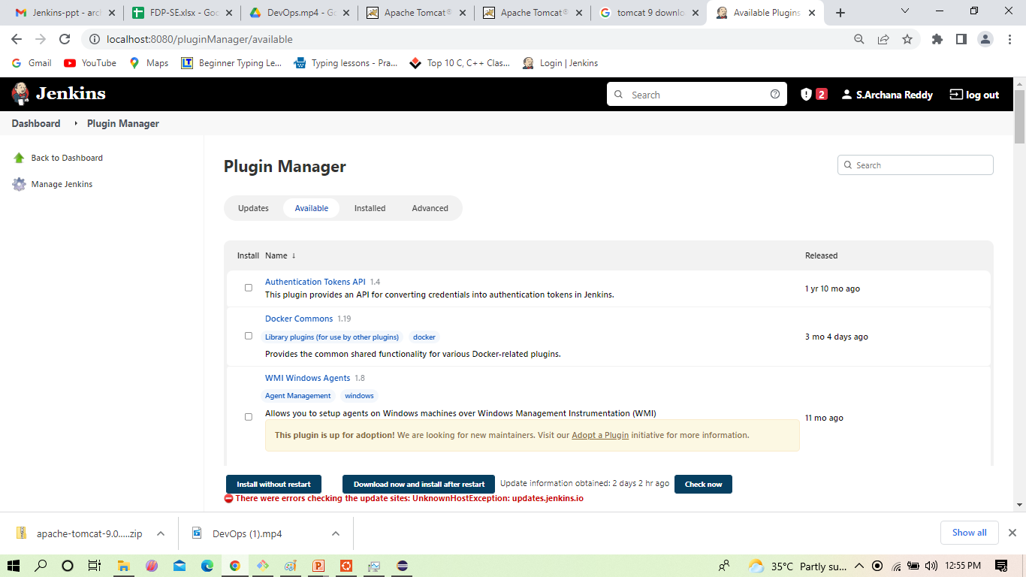
.
Install plugins in Jenkins Contd..
Check in the available and install the plugins Maven integration plugin, Build pipeline plugin, Pipeline utility, Copy artifacts, Deploy to container . click on -> install without restart

Slide 31
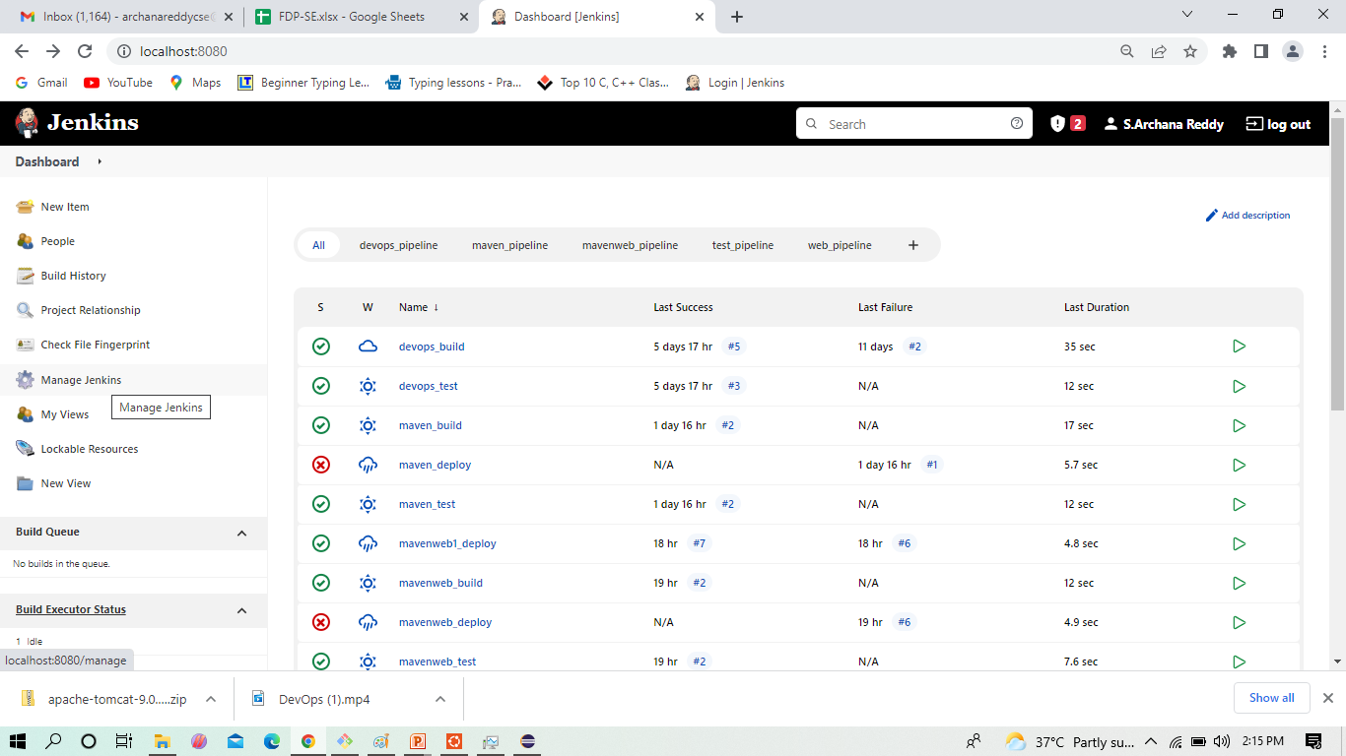
How to config your jenkins with maven
Configuration of Jenkins

Slide 32
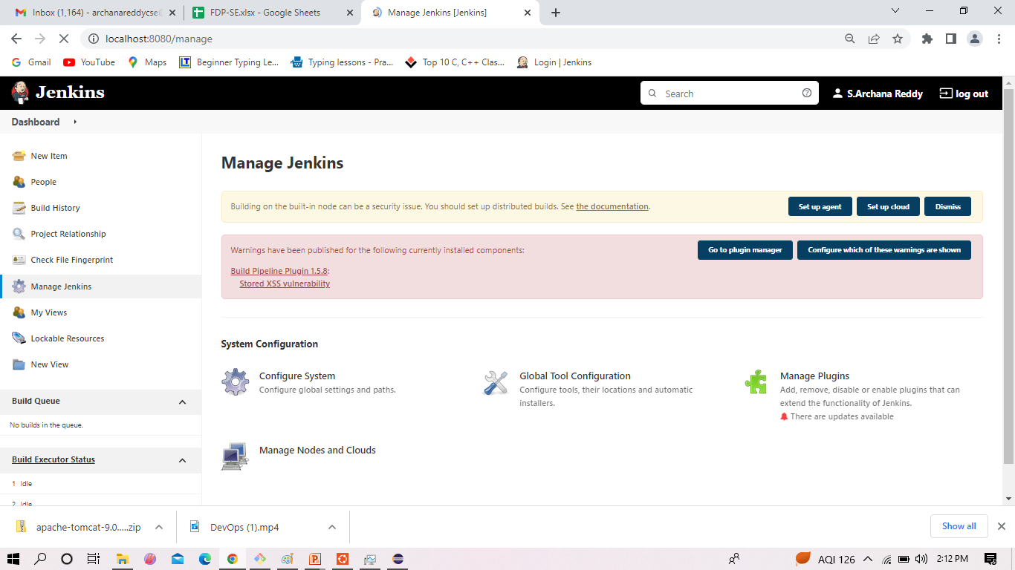
Select ->Global tool Configuration
Install plugins in Jenkins Contd..

Slide 33
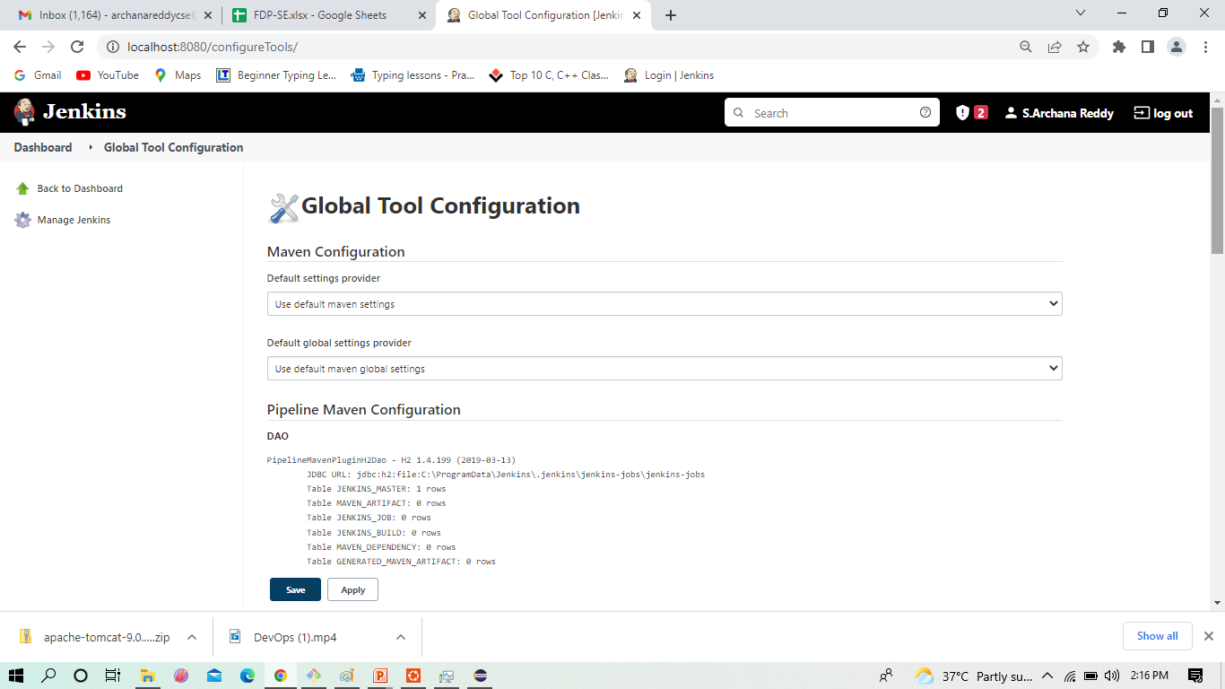
Page of Global Tool Configuration in same page go down for JDK
Install plugins in Jenkins Contd..

Slide 34
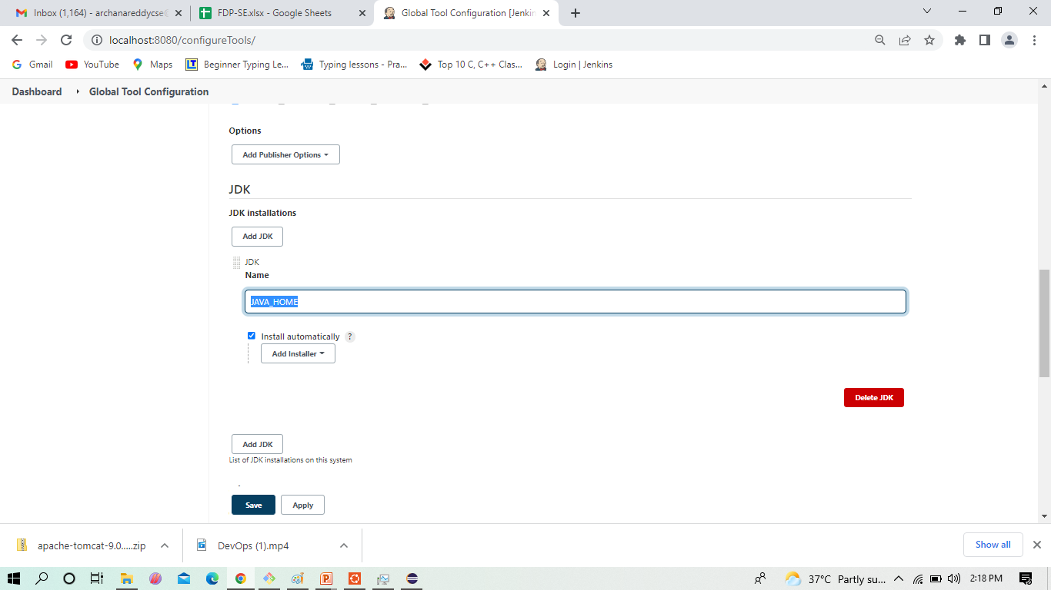
Here give the JAVA_HOME path
Install plugins in Jenkins Contd..

Slide 35
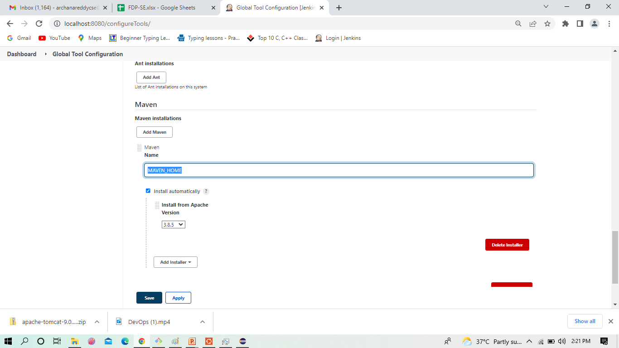
Next give the MAVEN _HOME path
Install plugins in Jenkins Contd..

Slide 36
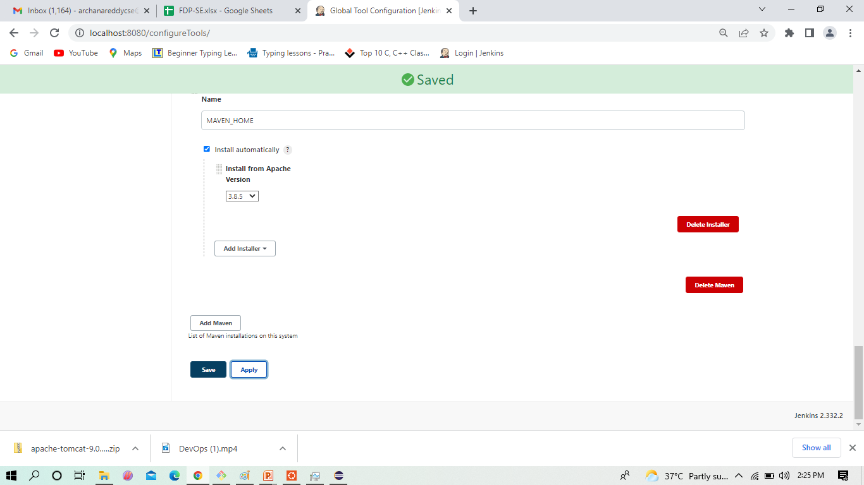
Click -> Apply and Save
Install plugins in Jenkins Contd..

